Slide 1
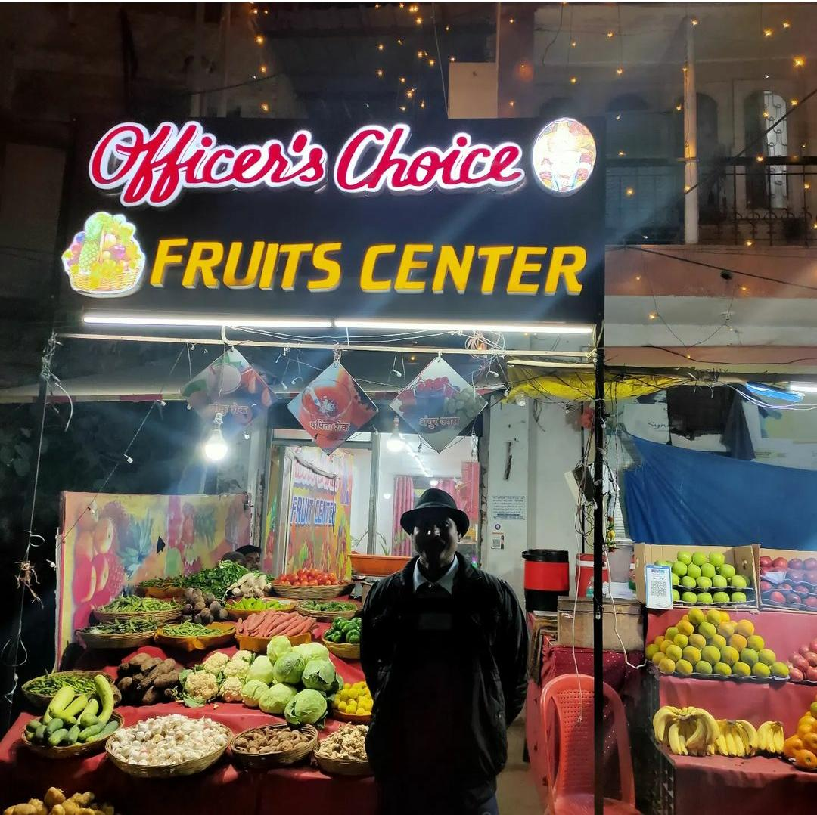
BUSINESS DATA MANAGEMENT – CAPSTONE PROJECT A STUDY ON JUICE CENTER – OFFICER’S CHOICE FRUITS CENTER
Owner – Mr. Ravi Bansal
Started on – 01/01/2016
Location - Dreamland, Simrol road , mhow , Indore
Business – Selling Packed fruit juice and shakes
(shakes and milk items they create their own)
Owner behaviour – He was kind. Helped me
by providing data written in his register.
Domain Of Analysis – On the basis of data I have ,
I have analysed Sales trend , Revenue trend , Gross
profit trend , Best performing SKU’s(Stock Keeping
unit) , Impact of covid-19

Slide 2
SALES TREND ANALYSIS
Classification Of Stock
Fast Moving Items | Slow Moving Item |  |  | Very Slow Moving Item
BADAM CHIKOO SHAKE | CRANBERRY JUICE |  |  | SHIKANJI
COLD COFFEE | KIWI JIUCE |  |  | KIWI LEMONADE
STRAWBERRY SHAKE | GREEN APPLE JUICE |  |  | LIME &MINT
APPLE JUICE | MIX FRUIT JUICE |  |  | BEETROOT JUICE
BANANA SHAKE | WATERMELON JUICE
ORANGE JUICE | MASALA LEMONADE
MANGO SHAKE
BUTTERMILK
KEENU JUICE
PINEAPPLE JUICE
CHIKOO JUICE
COCONUT WATER
ANAR JUICE
LASSI
GUAVA JUICE
LITCHI JUICE

Slide 3
REVENUE TREND ANALYSIS
Mango Shake is the highest revenue generating stock of overall month.
When we observe revenue vs sales graph
-> orange juice , Buttermilk , Pineapple juice , Apple Juice
take top 4 position in terms of best performing SKU.
June is the month where highest revenue is generated due to
high temperature and relax in covid – 19 restriction.

Slide 4
GROSS PROFIT TREND
Mango Shake performs well in terms of gross profit and revenue.
When we observe Revenue vs Gross Profit trend it seems that my top 4 performing SKU’s are:
-> Mango Shake , Orange juice , Cold Coffee , Strawberry Shake .
There is decrease in gross profit percentage in May ,
June , July as covid – 19 restrictions increased in many other regions and raw material price starts to increase.

Slide 5
RECOMMENDATIONS
He should stop purchase of very slowing moving SKU’s ( Shikanji , Kiwi Lemonade , Lime and Mint , Beetroot Juice) because large value of average day’s of inventory and high cost of maintenance.
Slow moving SKU’s purchase should be reduced.
Top SKU’s in terms of Revenue , Sales and gross profit ->
I suggested him to focus more on these SKU’s and increase there inventory
Shakes and milk product gives large contribution in his business in comparison of fruit juice’s
so I suggest him to increase milk products and try to create more variety in Fruit Shakes.
I have suggested him to enrol his shop on online food delivery platform.
Since foreign fruit like Kiwi , Crane berry , Keenu are alien to Indian taste buds so sales of these products are low so I have suggested to limit its purchase.
MANGO SHAKE
COLD COFFEE
ORANGE JUICE
STRAWBERRY SHAKE
APPLE JUICE
PINEAPPLE JUICE
BUTTERMILK
WATERMELON JUICE
BADAM CHIKOO SHAKE
BANANA SHAKE
CHIKOO JUICE
LASSI

